Slide 1

Sales distribution dashboard

Slide 2
PRESENT A DASHBOARD ANALYSIS SHOWCASING THE EFFECTIVENESS OF EACH SEGMENT, PRODUCT, CUSTOMER, MONTH, And DAY IN THE DISTRIBUTION OF SALES TO ANALYZE CUSTOMER SALES DISTRIBUTION.
CREATE A POWERPOINT PRESENTATION OUTLINING THE ANALYSIS THAT CAN BE PRESENTED TO THE MANAGEMENT.
To conduct a thorough analysis, I thoroughly reviewed the tasks of the project and identified the tasks that needed to be completed and the resulting outcomes. This process involved gathering relevant data and analyzing it to uncover any patterns and trends. Throughout the project, certain skills were essential, while others were learned along the way. Examples of necessary skills included Analyzing Data Quality, Cleaning Data, Creating Analytical Dashboards, Performing Data analytics, Segmenting Customers, Presenting Data-driven insights, Developing Data dashboards, Creating Data Visualizations, and Delivering Presentations.

Slide 3
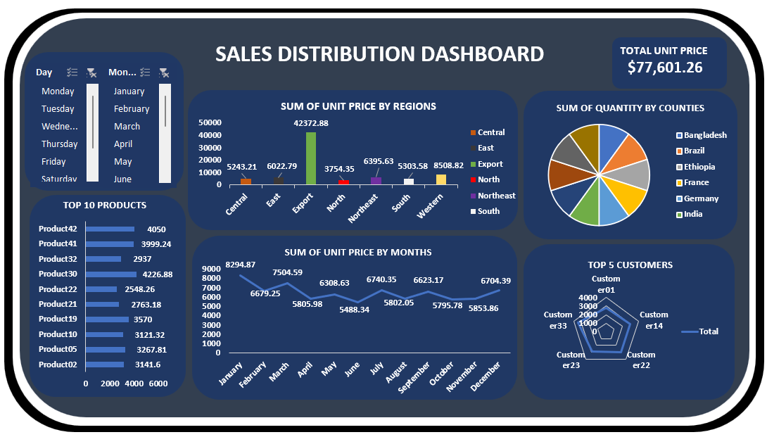
Sales dashboard

Slide 4
TO RECEIVE MORE UPDATES, MAKE SURE HIT THE FOLLOW BUTTON TO LIKE AND COMMENT: LINKEDIN.COM/IN/ABIODUN-O
Thank you for staying till the end

Slide 5
Sales dashboard

